Slide 1

Optimizing a function of a vector variable

Slide 2
Introduction
In this topic, we will
Describe what will be covered in the next section
Optimization of functions of a vector variable
Discuss how this is more difficult than finding a minimum of a function of a real variable
Describe the algorithms that will be covered

Slide 3
The problem
With a differentiable function of one variable, if the function increases in one direction, it decreases in the other
With a function of even a 2-dimensional vector, we now have infinitely many directions to consider
If the function is sufficiently differentiable, we can calculate the gradient
The gradient yields the direction of maximum increase
The opposite direction is the direction of maximum decrease

Slide 4
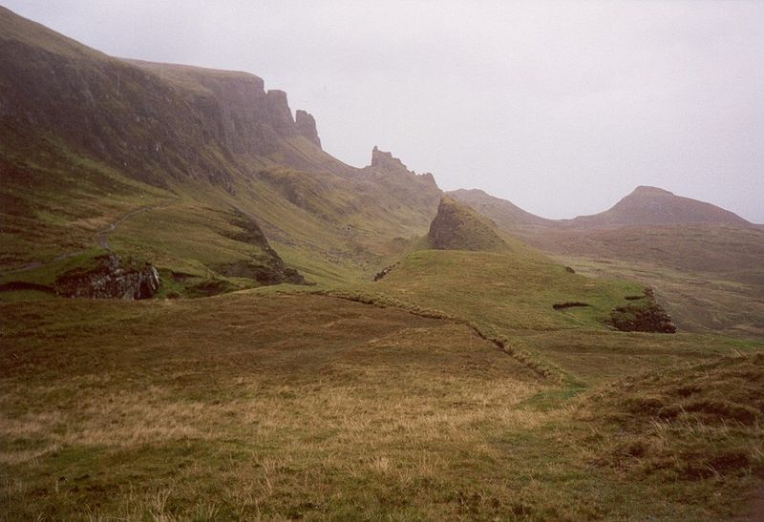
Getting home
Suppose you’re in the Scottish highlands and its foggy
You’d like to get home, which is in the valley
Given no global information, to get down in the most timely, you’d walk in the direction that is steepest downhill
Warwick Bradly August 2001 on Canon Elph

Slide 5
Properties of an extrumum
For a sufficiently differentiable function at a minimum, the slope in any direction is zero
Unfortunately, the function at a point could be a minimum in every variable but one, causing the point to be a saddle point
For example, this function has a minimum at u = 0:
Both of these are saddle points at that same point:

Slide 6
Looking ahead
We will look at:
The Hooke-Jeeves method
A generalization of the step-by-step algorithm that walks towards the minimum
Newton’s method for finding extrema in n dimensions
A generalization of Newton’s method applied to the derivative
Gradient descent
Converting a problem in n dimensions to a problem in one dimension

Slide 7
Summary
Following this topic, you now
Have an overview of the ideas to be covered in this section
Understand that we will look at three algorithms for optimizing a real-valued function of a vector variable

Slide 8
References
[1] https://en.wikipedia.org/wiki/Mathematical_optimization

Slide 9
Acknowledgments
None so far.

Slide 10



Colophon
These slides were prepared using the Cambria typeface. Mathematical equations use Times New Roman, and source code is presented using Consolas. Mathematical equations are prepared in MathType by Design Science, Inc.
Examples may be formulated and checked using Maple by Maplesoft, Inc.
The photographs of flowers and a monarch butter appearing on the title slide and accenting the top of each other slide were taken at the Royal Botanical Gardens in October of 2017 by Douglas Wilhelm Harder. Please see
https://www.rbg.ca/
for more information.

Slide 11
Disclaimer
These slides are provided for the ece 204 Numerical methods course taught at the University of Waterloo. The material in it reflects the author’s best judgment in light of the information available to them at the time of preparation. Any reliance on these course slides by any party for any other purpose are the responsibility of such parties. The authors accept no responsibility for damages, if any, suffered by any party as a result of decisions made or actions based on these course slides for any other purpose than that for which it was intended.

